Slide 1
Experiment 2
Measurement of Voltage, Current and Power by Voltage, Current and Power Transducers
B. Tech in Power Engineering 3rd Year
Jadavpur University
Subject: Transducer and Control Lab

Slide 2
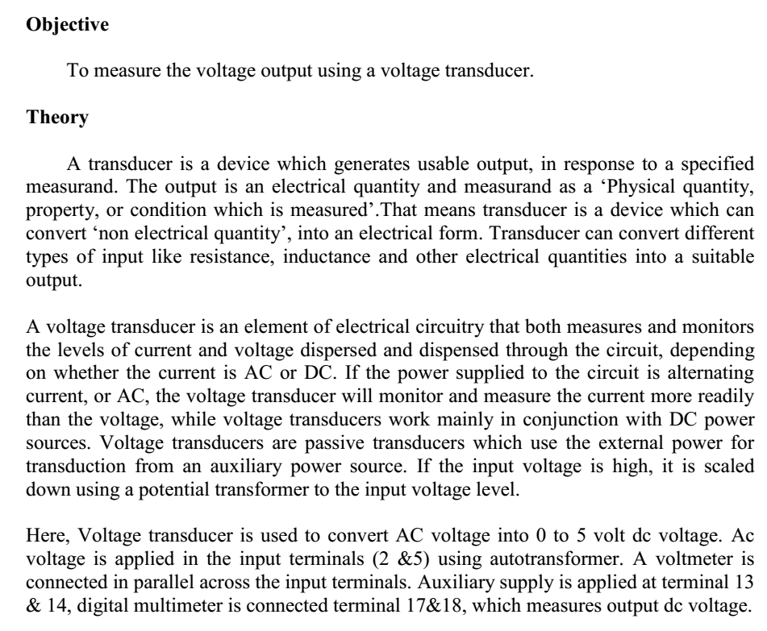
Measurement of Voltage using Voltage Transducer

Slide 3
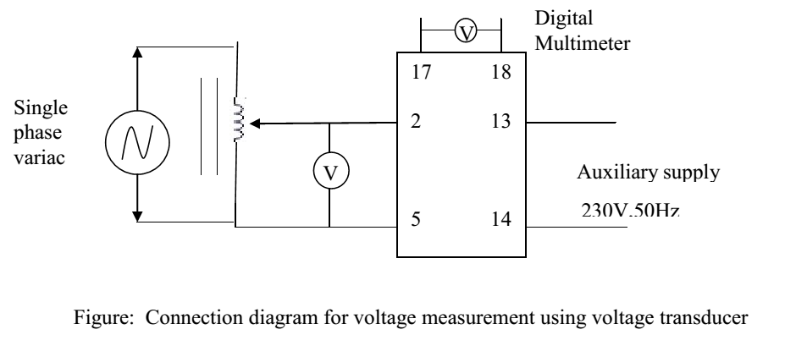
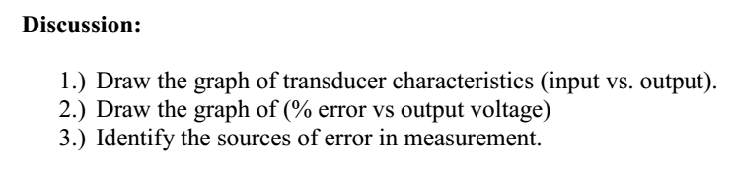
Circuit Diagram of Voltage Transducer

Slide 4
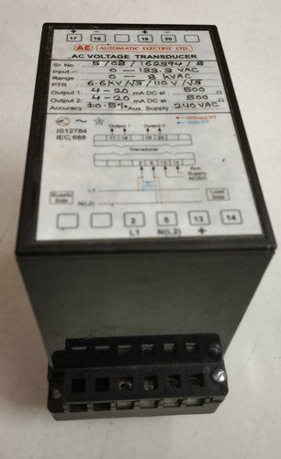
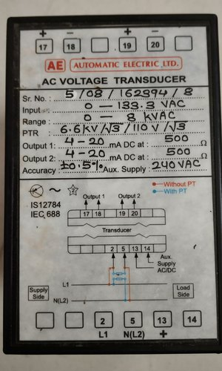

Slide 5
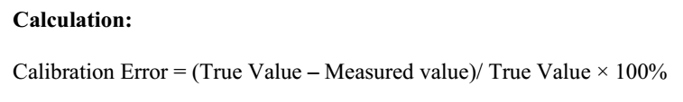
Observation Table
Sl. No. | Input AC voltage (V) | Output Measured DC voltage (V) | True DC voltage (V) | % Calibration Error
1. | 0 | 0 | 0 | 0
2. | 20 | 0.42 | 0.45 | 6.67%
3. | 50 | 1.10 | 1.14 | 3.5%
4. | 80 | 1.78 | 1.82 | 2.2%
5. | 100 | 2.24 | 2.27 | 1.3%
6. | 120 | 2.7 | 2.72 | 0.7%
7. | 140 | 3.14 | 3.18 | 1.26%
8. | 160 | 3.6 | 3.64 | 1.1%
9. | 200 | 4.5 | 4.54 | 0.9%
10. | 220 | 4.96 | 5.00 | 0.8%

Slide 6
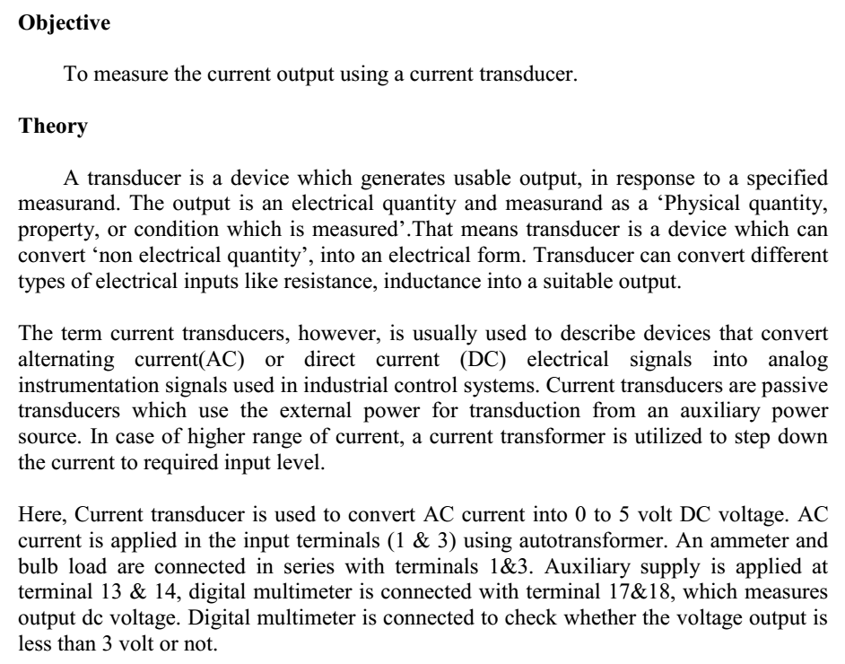
Measurement of Current using Current Transducer

Slide 7
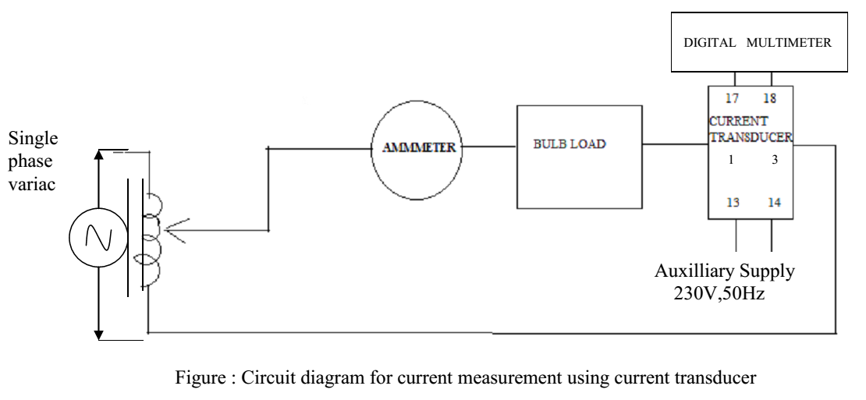
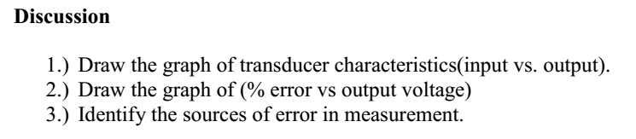
Circuit Diagram of Current Transducer

Slide 8
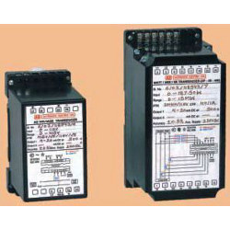

Slide 9
Electrical Specifications
Type Ohm, DC / AC Voltage, DC / AC Current, Frequency, Summation, Power Factor, DC / AC Watt, Var, VA Transducers.
•Input Range: Voltage 0 - 500V DC / 0 - 500V AC.
Current 0 - 5A DC (for higher ranges 50 - 300mV ext. Shunt) / 0 - 5A AC.
Frequency 50 / 60Hz ± 5hz., 400hz ± 20Hz. (other Frequency on request).
Power Factor 0.5% (lag) - unity - 0.5(lead). (Refer Note 4)
Resistance 0 - 500Ω for Ohm Transducer
Accuracy 0.5% of f.s.d. for Ohm, Voltage, Current, Summation, Power Factor, Watt, Var, VA Transducers.
For Frequency Transducer - 0.2% of Centre frequency.
AUX. Supply 63.5V, 110V, 220V, 230V, 240V, 380V, 415V, 440V AC ±10%, 50/60Hz. 24V, 48V, 110V, 220V DC ±10%
•VA Burden For VOLTAGE ≤ 1.0, For CURRENT ≤ 0.5, for AUX Supply ≤ 4.0

Slide 10
Observation Table
Sl. No. | Input AC current (A) | Output Measured DC voltage (V) | True DC voltage (V) | % Calibration Error
1. | 0.0 | 0.0 | 0.0 | 0
2. | 0.5 | 0.48 | 0.5 | 4%
3. | 1.0 | 0.98 | 1.0 | 2%
4. | 1.5 | 1.46 | 1.5 | 2.7%
5. | 2.0 | 1.96 | 2.0 | 2%
6. | 2.5 | 2.45 | 2.5 | 2%
7. | 3.0 | 2.95 | 3.0 | 1.7%
8. | 4.0 | 3.94 | 4.0 | 1.5%
9. | 4.5 | 4.45 | 4.5 | 1.11%
10. | 5.0 | 4.94 | 5.0 | 1.2%

Slide 11
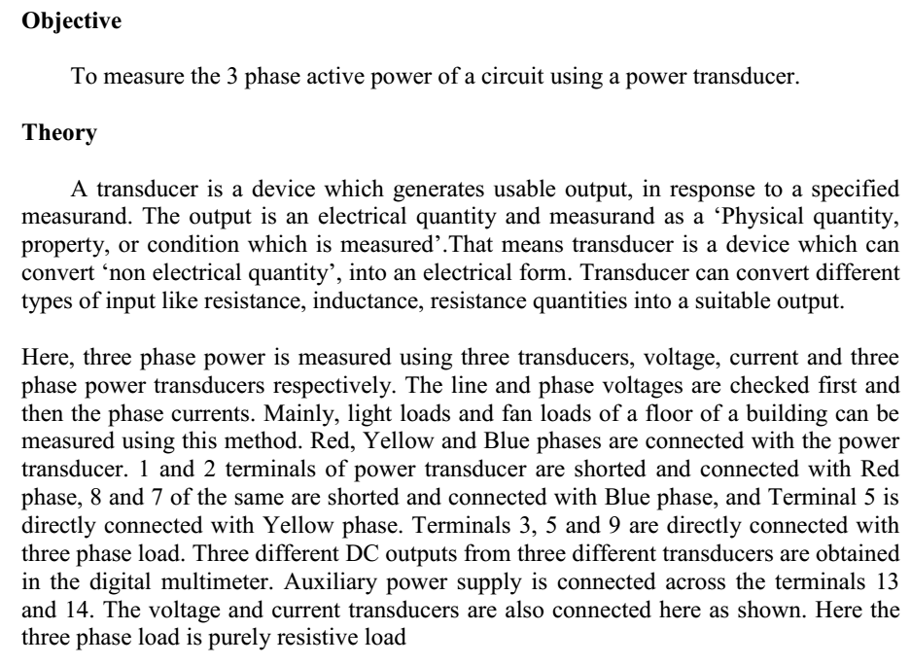
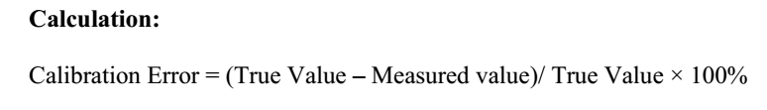
Measurement of Three Phase Power using Power Transducer

Slide 12
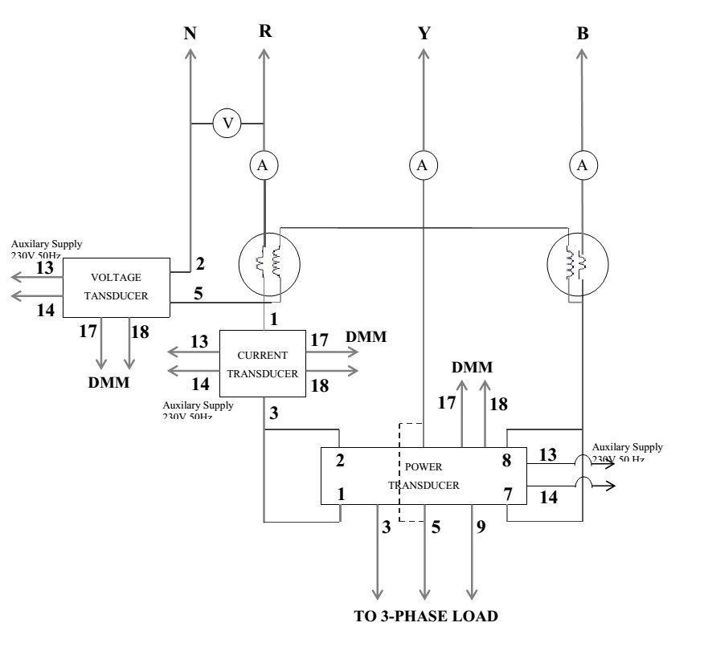
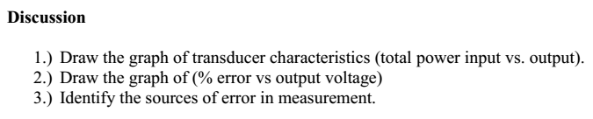
Circuit Diagram of Power Transducer

Slide 13
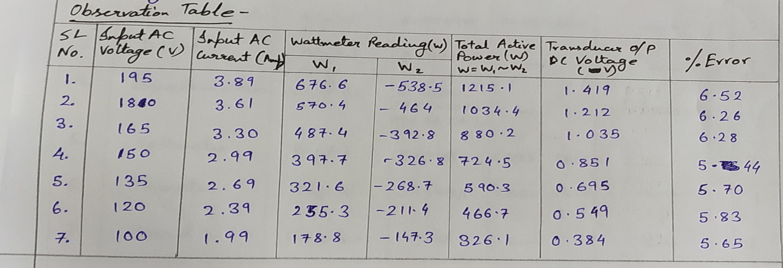
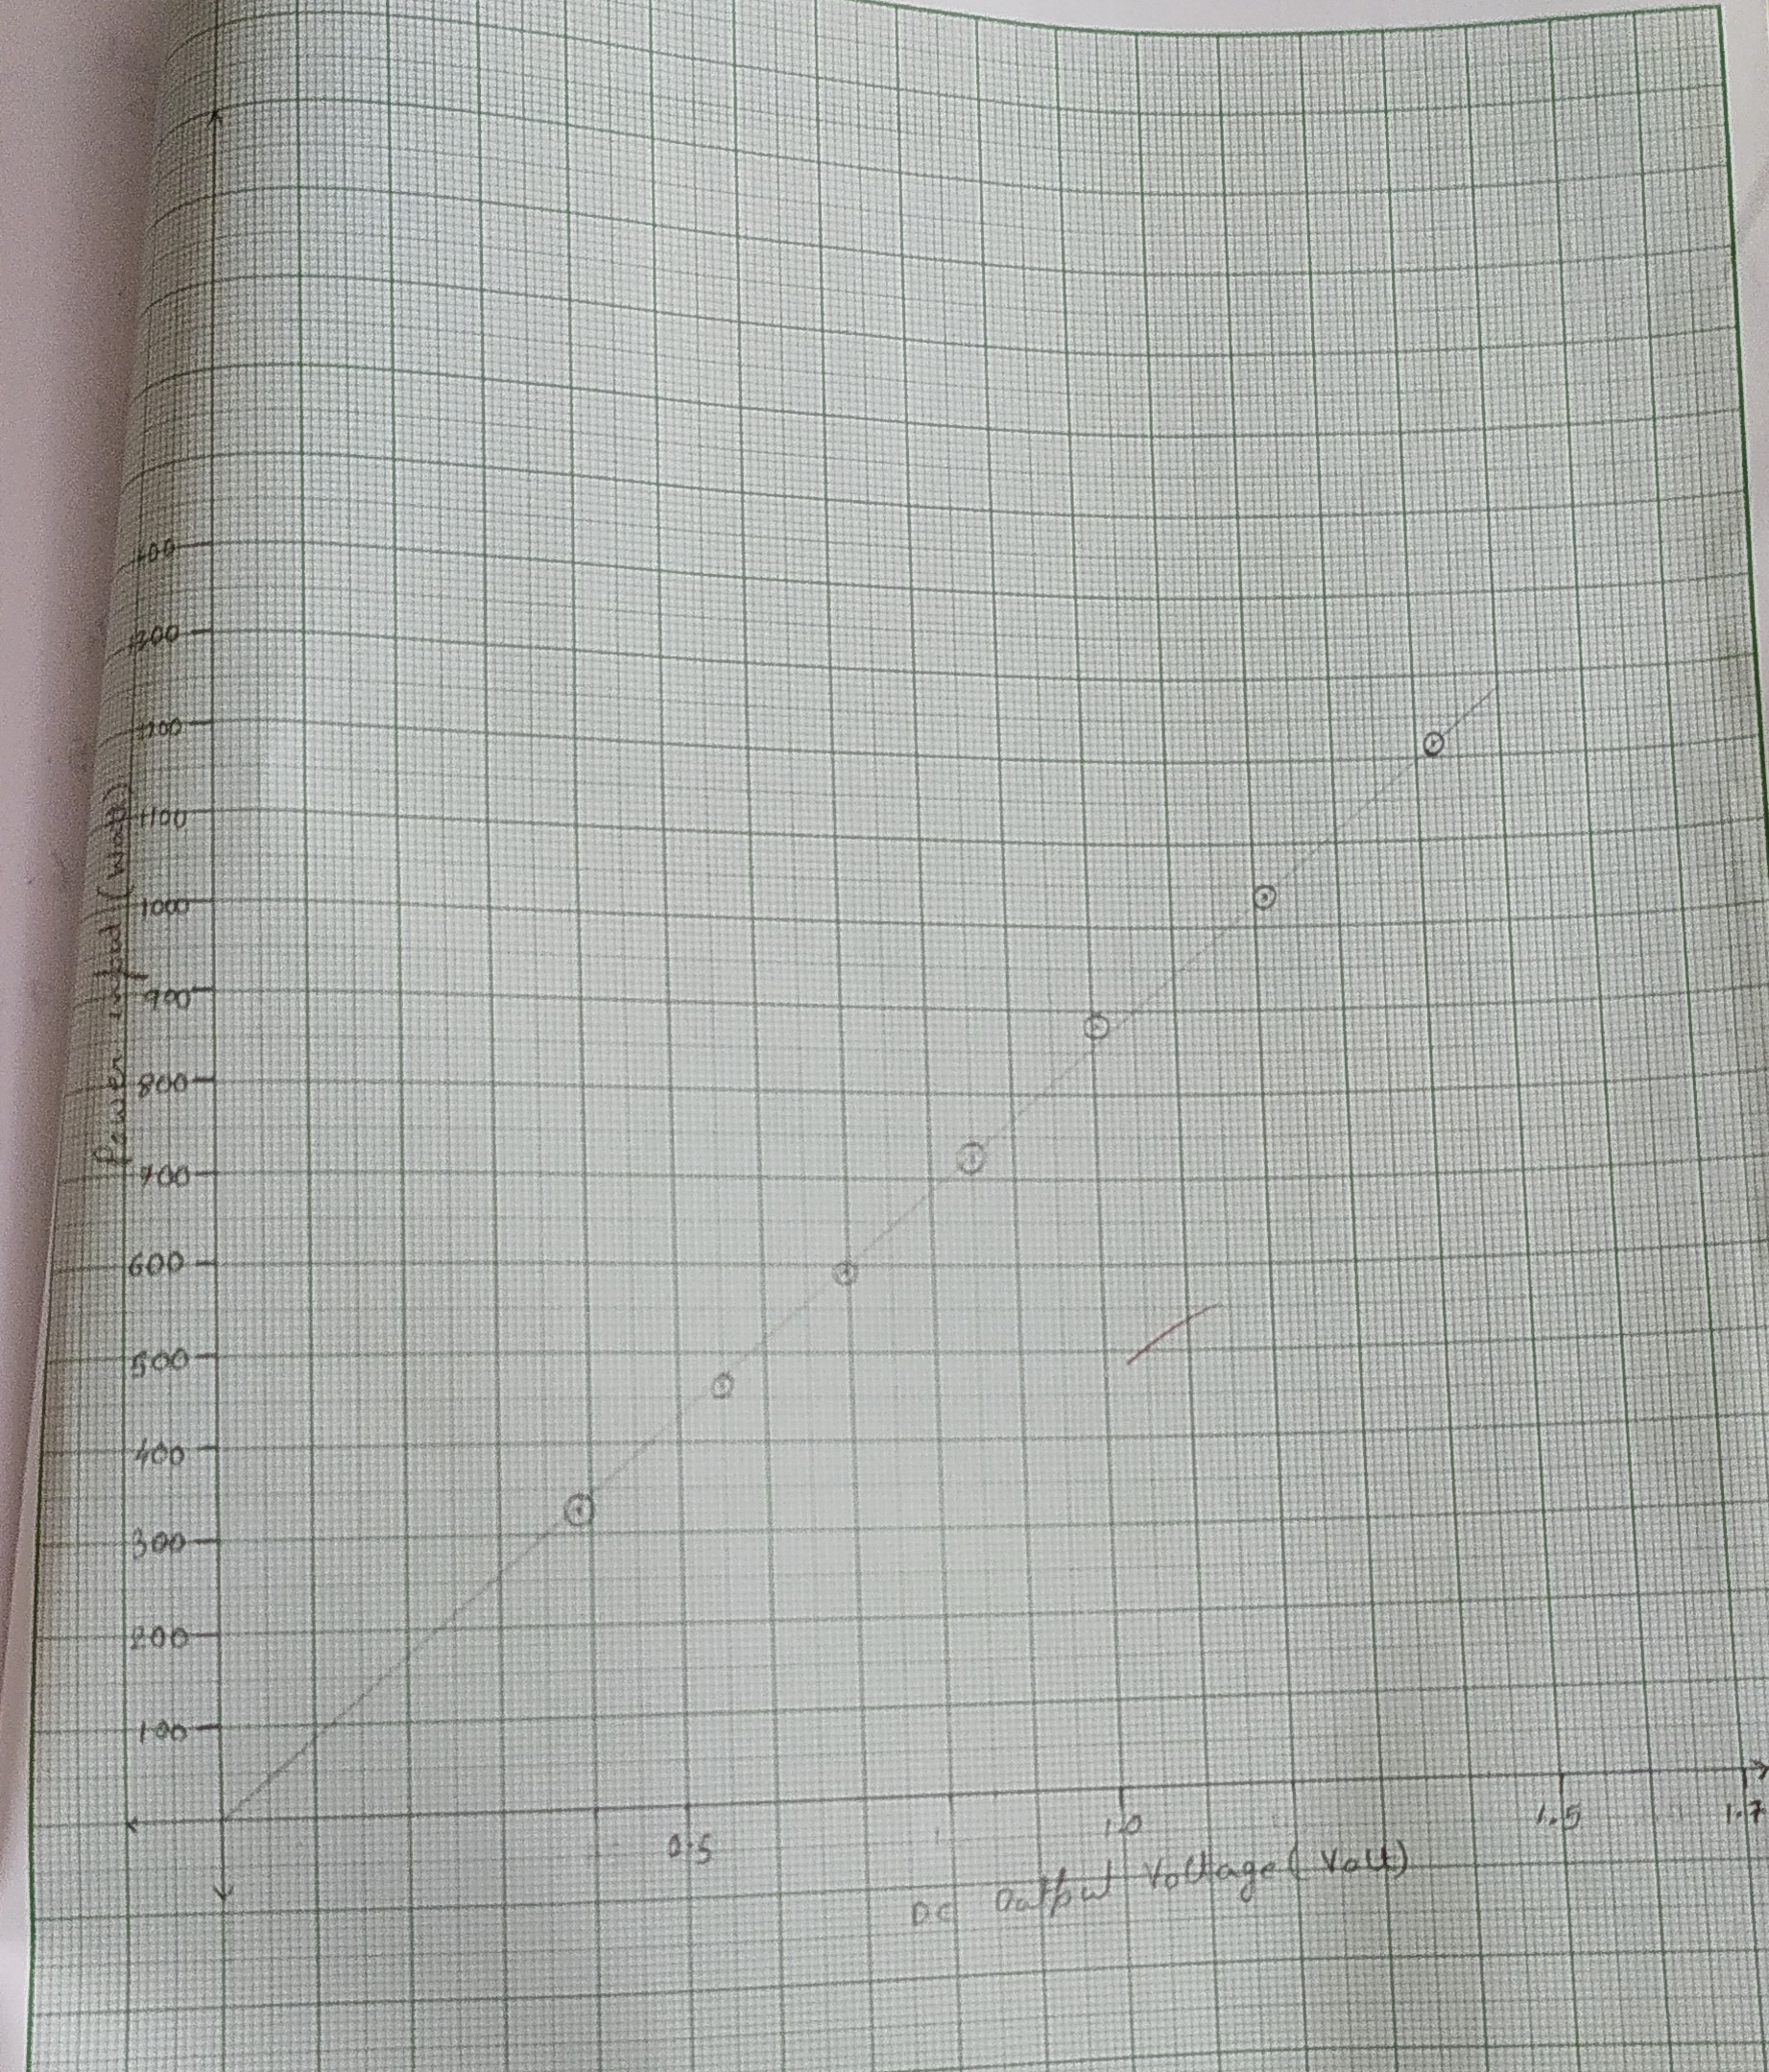
Observation Table

